Slide 1
Molecular Biology 101
Fall 2017
BMI/CS 576
www.biostat.wisc.edu/bmi576/
Irene Ong
irene.ong@wisc.edu

Slide 2
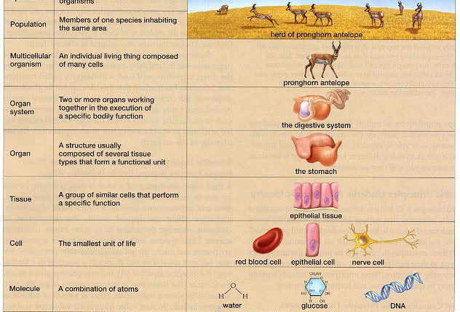

Levels of the biological hierarchy
Ecosystem
Lake Monona, Mojave desert, …
Population
Madison Humans, Monona Muskie
Organism
Pine tree, Lizard, Human…
Organ
Heart, Lungs, Brain…
Tissue
Adipose tissue, Blood, Nerve tissue…
Cell
Fat cell, Blood cell, Muscle cell…
Organelle
Nucleus, Mitochondrion…
Molecule
DNA, RNA, Protein, Lipids…
Edition 9 of Biology, by Audesirk et. al.

Slide 3
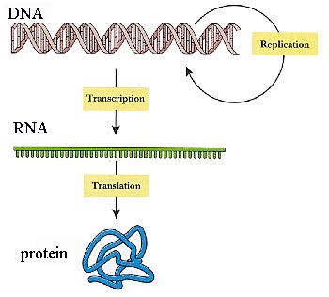
The Central Dogma
Reverse
transcription

Slide 4
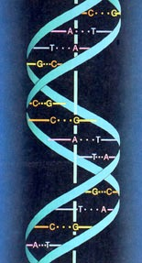
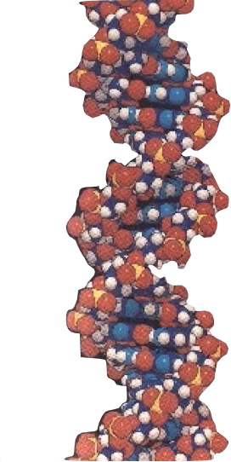
DNA
DeoxyriboNucleic Acid – two strands - double helix
can be thought of as the “blueprint” for an organism
a linear chain of small molecules called nucleotides
four different nucleotides:
adenine (A), cytosine (C), guanine (G) and thymine (T)
is a polymer: large molecule consisting of similar units (nucleotides in this case)
a single strand of DNA can be thought of as a string composed of the four letters: A, C, G, T
ctgctggaccgggtgctaggaccctgactgcccggggccgggggtgcggggcccgctgag…

Slide 5
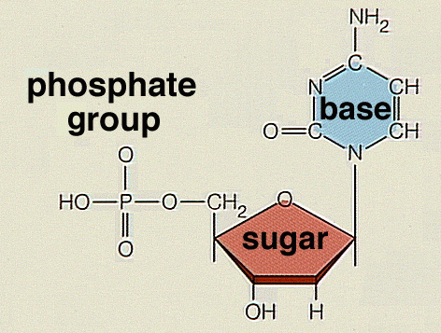
Nucleotides: the subunits of DNA
5’
1’
4’
3’
2’

Slide 6
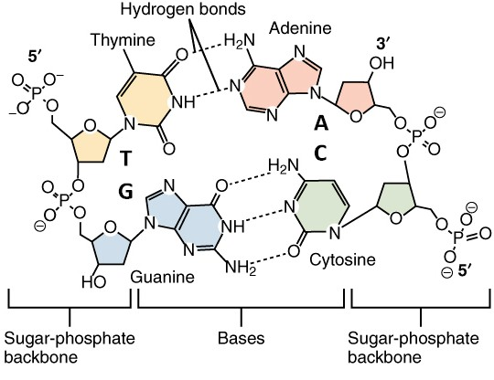
The four DNA bases
2’
3’
4’
5’
5’
1’
4’
1’
3’
2’
2’
3’
1’
4’
5’
5’
4’
1’
3’
2’
3’

Slide 7
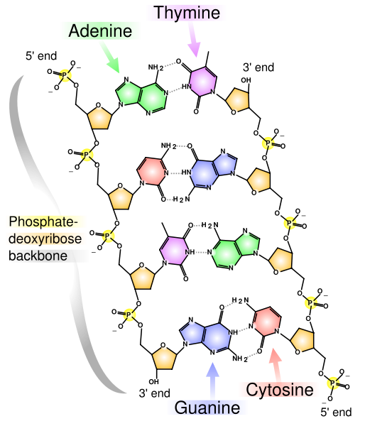
DNA strand: polymer of nucleotides
in double-stranded DNA
A always bonds to T
C always bonds to G

Slide 8
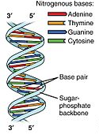
The Double Helix
each strand of DNA has a “direction”
at one end, the terminal carbon atom in the backbone is the 5’ carbon atom of the terminal sugar
at the other end, the terminal carbon atom is the 3’ carbon atom of the terminal sugar
therefore we can talk about the 5’ and the 3’ ends of a DNA strand
in a double helix, the strands are antiparallel (arrows drawn from the 5’ end to the 3’ end go in opposite directions)

Slide 9
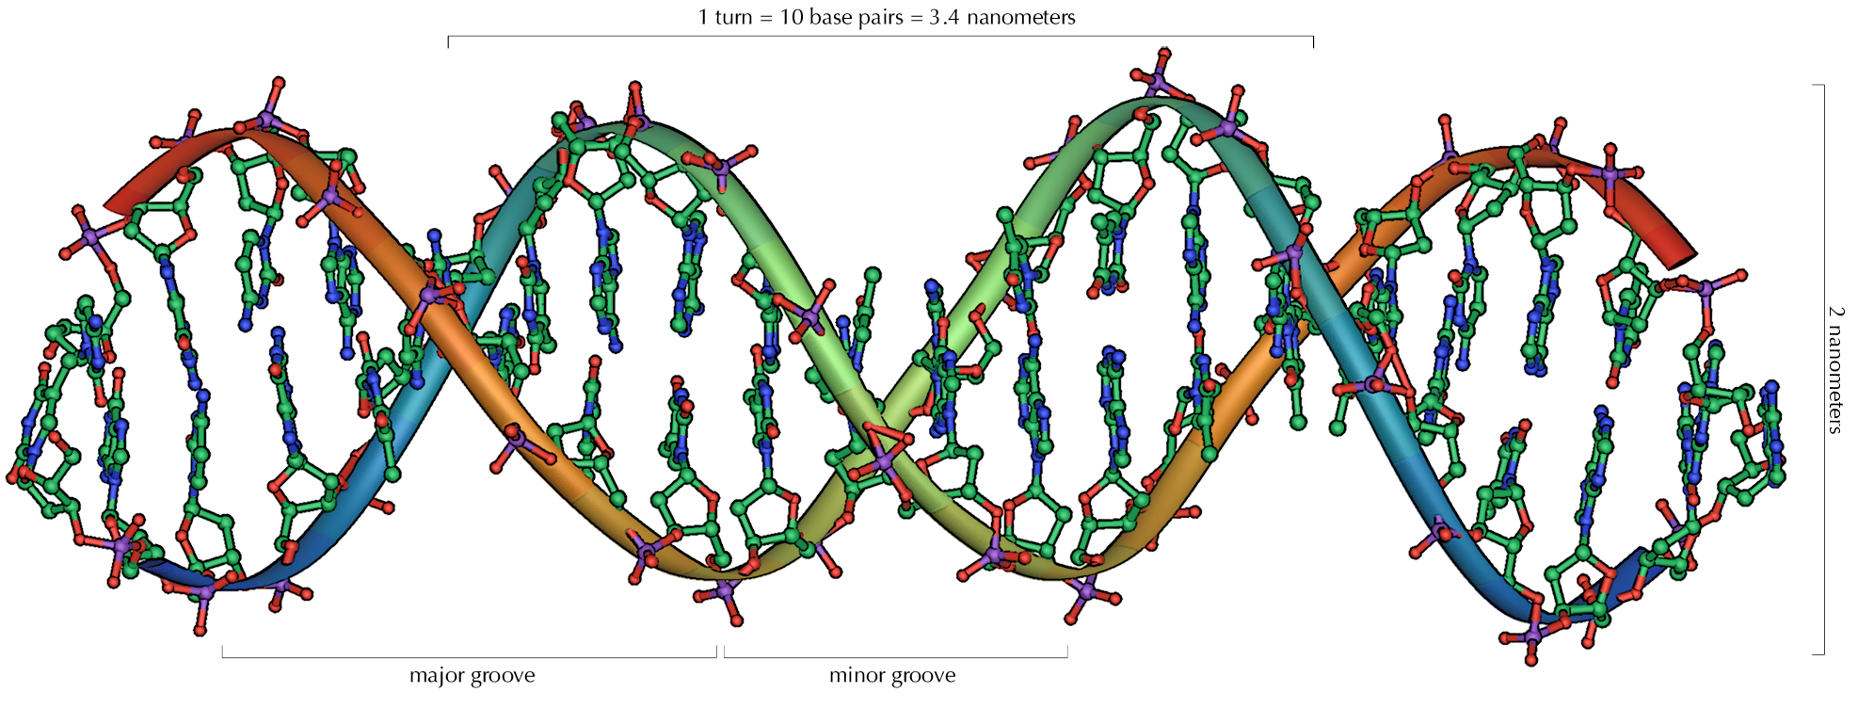
DNA dimensions

Slide 10
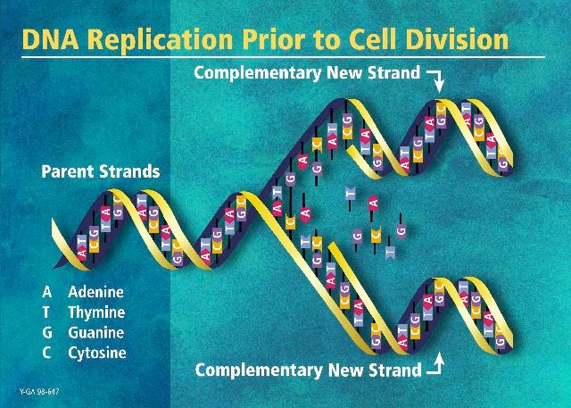
image from the DOE Human Genome Program
http://www.ornl.gov/hgmis

Slide 11
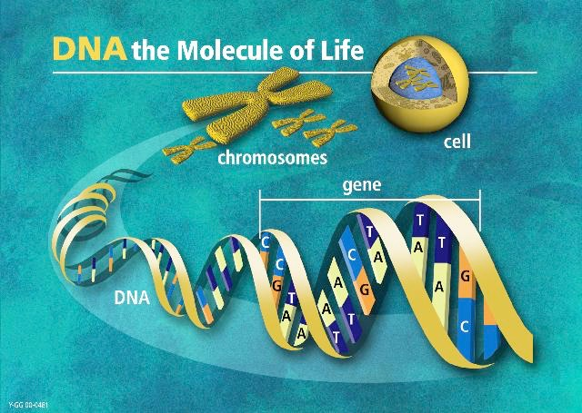
image from the DOE Human Genome Program
http://www.ornl.gov/hgmis

Slide 12
Chromosomes
DNA is packaged into individual chromosomes (along with proteins)
prokaryotes (single-celled organisms lacking nuclei) typically have a single circular chromosome
eukaryotes (organisms with nuclei) have a species-specific number of linear chromosomes

Slide 13
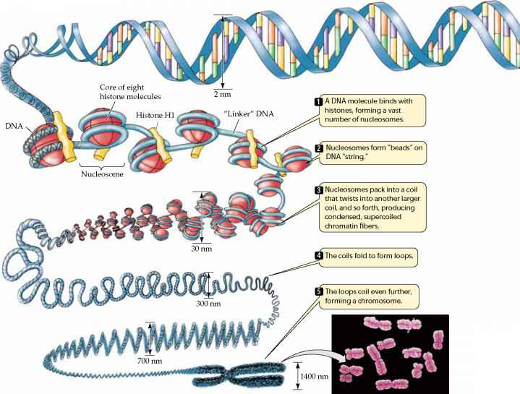

Slide 14
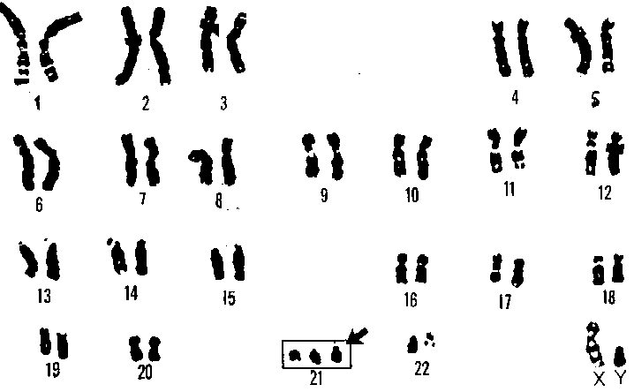
Human Chromosomes

Slide 15
Genomes
the term genome refers to the complete complement of DNA for a given species
the human genome consists of 46 chromosomes (23 pairs)
every cell (except sex cells and mature red blood cells) contains the complete genome of an organism

Slide 16
The Central Dogma

Slide 17
Examples of proteins
Protein | Role
alpha-keratin | component of hair
beta-keratin | component of scales
insulin | regulates blood glucose level
actin & myosin | muscle contraction
DNA polymerase | synthesis of DNA
ATP synthase | makes ATP
hemoglobin | transport of oxygen
endonuclease | cuts DNA (restriction enzyme)

Slide 18
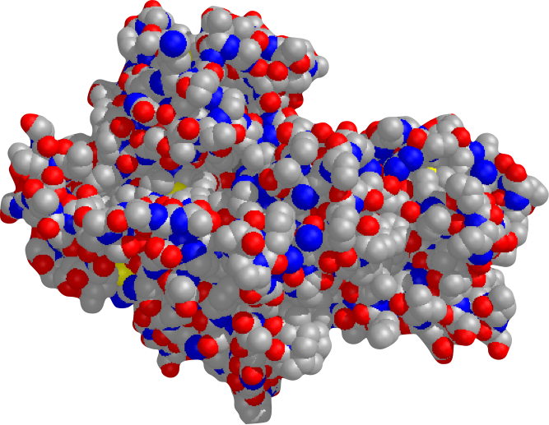
Space-Filling Model of Hexokinase

Slide 19
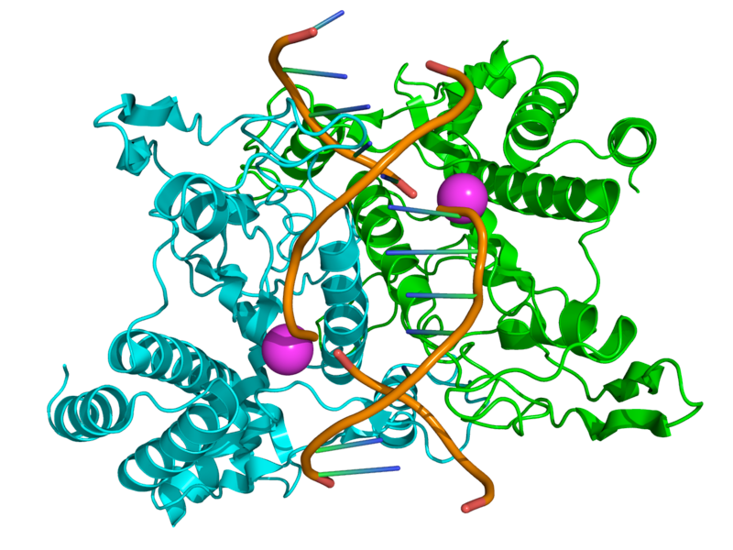
EcoRI – restriction enzyme

Slide 20
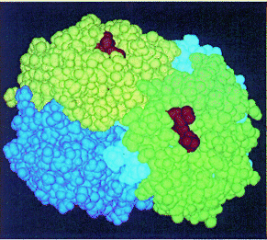
Hemoglobin
protein built from 4 polypeptides
responsible for carrying oxygen in red blood cells

Slide 21
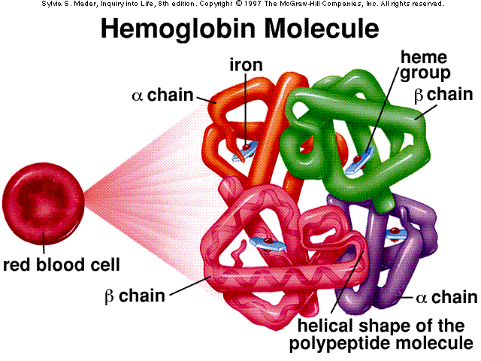
Hemoglobin: carrier of oxygen

Slide 22
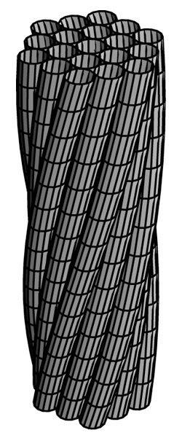
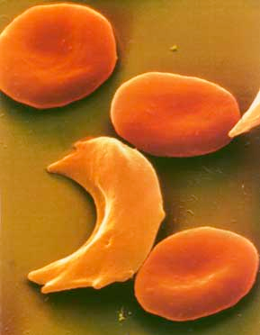
Mutant β-globin → Sickle blood cells
Fiber of sickle hemoglobin
Sickle and normal blood cells

Slide 23
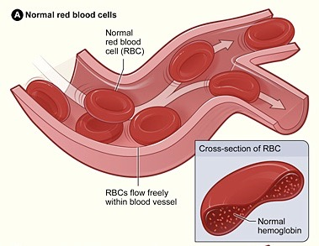
Normal blood flow

Slide 24
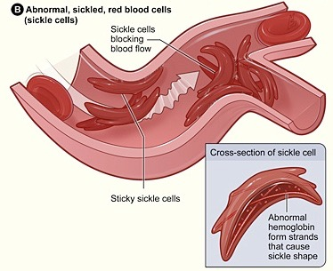
Sickle cell complications

Slide 25
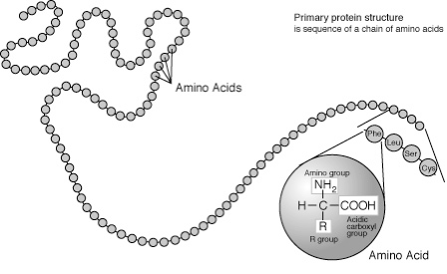
Protein: polymers of amino acids

Slide 26
Proteins
proteins are molecules composed of one or more polypeptides
a polypeptide is a polymer composed of amino acids
cells build their proteins from 20 different amino acids
a polypeptide can be thought of as a string composed from a 20-character alphabet

Slide 27
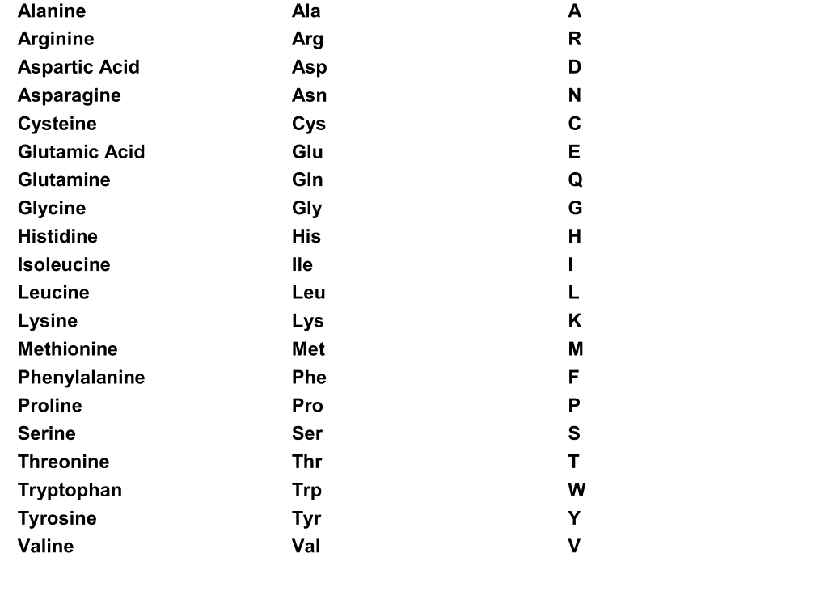
Amino Acids

Slide 28
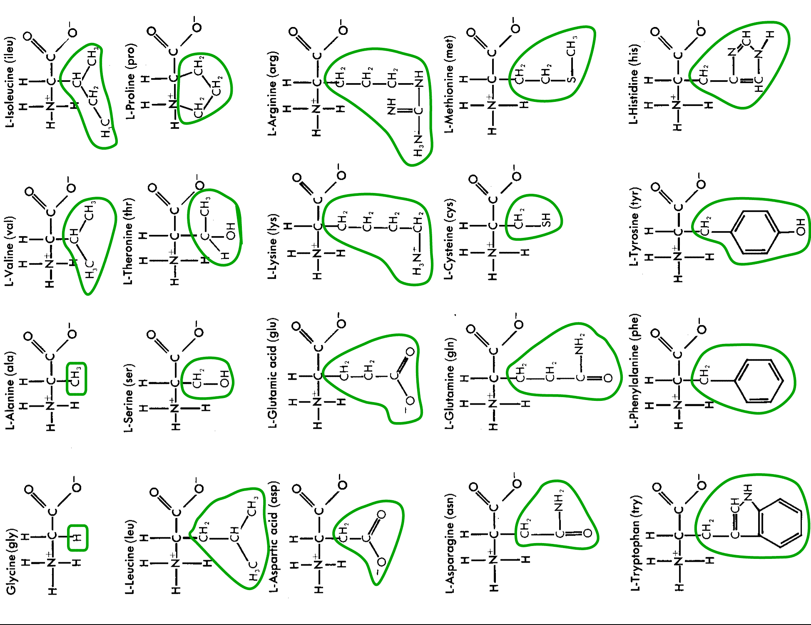
The alphabet of protein: 20 amino acids

Slide 29
Amino Acid Sequence of Hexokinase
1 A A S X D X S L V E V H X X V F I V P P X I L Q A V V S I A
31 T T R X D D X D S A A A S I P M V P G W V L K Q V X G S Q A
61 G S F L A I V M G G G D L E V I L I X L A G Y Q E S S I X A
91 S R S L A A S M X T T A I P S D L W G N X A X S N A A F S S
121 X E F S S X A G S V P L G F T F X E A G A K E X V I K G Q I
151 T X Q A X A F S L A X L X K L I S A M X N A X F P A G D X X
181 X X V A D I X D S H G I L X X V N Y T D A X I K M G I I F G
211 S G V N A A Y W C D S T X I A D A A D A G X X G G A G X M X
241 V C C X Q D S F R K A F P S L P Q I X Y X X T L N X X S P X
271 A X K T F E K N S X A K N X G Q S L R D V L M X Y K X X G Q
301 X H X X X A X D F X A A N V E N S S Y P A K I Q K L P H F D
331 L R X X X D L F X G D Q G I A X K T X M K X V V R R X L F L
361 I A A Y A F R L V V C X I X A I C Q K K G Y S S G H I A A X
391 G S X R D Y S G F S X N S A T X N X N I Y G W P Q S A X X S
421 K P I X I T P A I D G E G A A X X V I X S I A S S Q X X X A
451 X X S A X X A

Slide 30
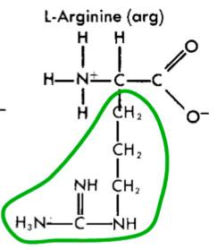
Nucleotides vs. Amino Acids
Nucleotide
Amino Acid
Both made up of “backbone” and “residue” parts

Slide 31
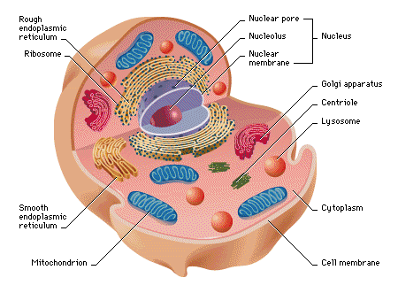
The inaccessible code
DNA is in the nucleus
Proteins are (mostly) made in the cytoplasm
(eukaryotic cell)

Slide 32
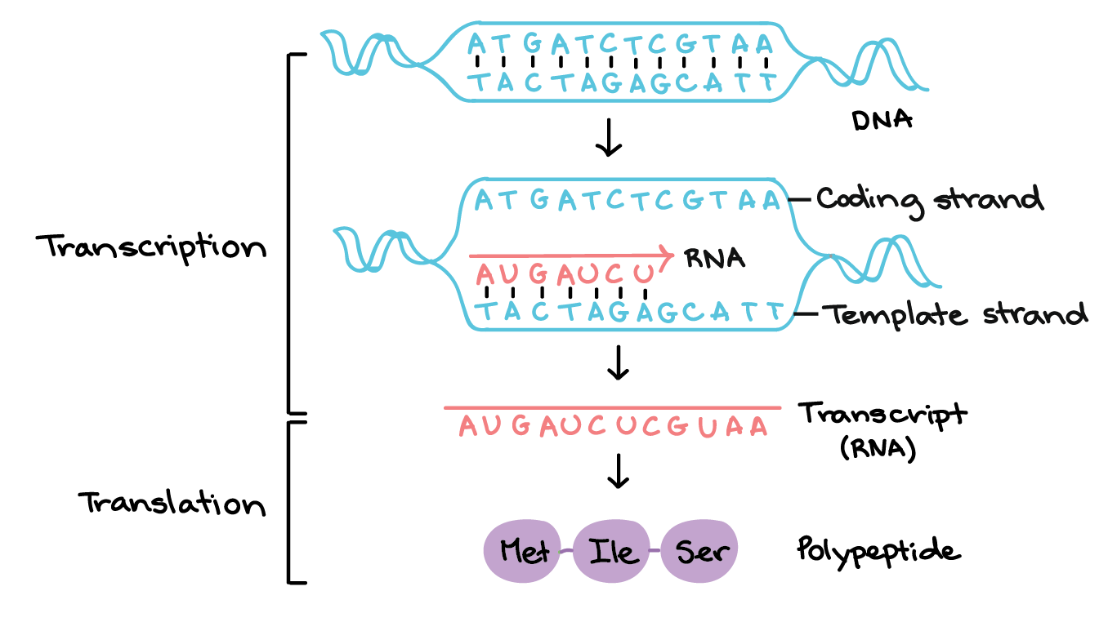
The Central Dogma

Slide 33
Transcription
RNA polymerase is the enzyme that builds an RNA strand from a gene within DNA
RNA that is transcribed from a gene is called messenger RNA (mRNA)

Slide 34
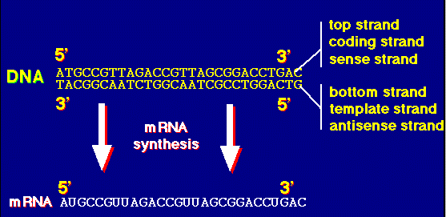
Transcription
RNA that is transcribed from a protein-coding gene is called messenger RNA (mRNA)
RNA polymerase is the enzyme that builds an RNA molecule from a gene

Slide 35
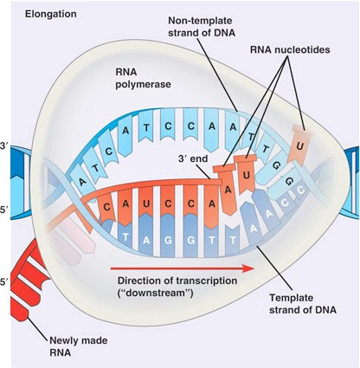
Transcription: DNA→RNA

Slide 36
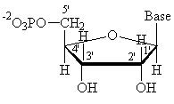

RNA vs. DNA structure
DNA | RNA
linear polymer | linear polymer
double-stranded | single-stranded
deoxyribonucleotide monomer | ribonucleotide monomer
A,C,G,T bases | A,C,G,U bases

Slide 37
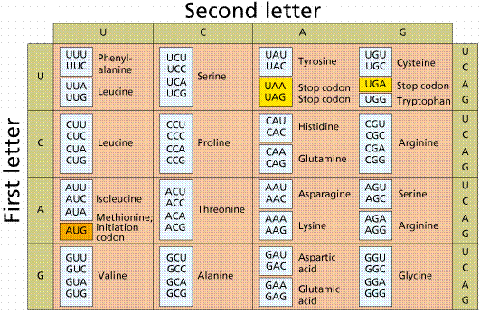
The Genetic Code

Slide 38
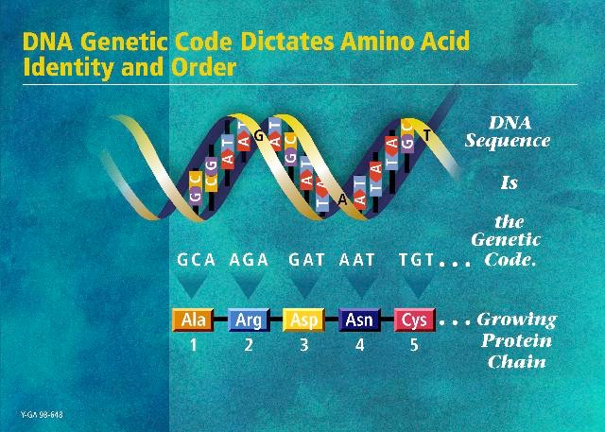
image from the DOE Human Genome Program
http://www.ornl.gov/hgmis

Slide 39
Translation
ribosomes are the machines that synthesize proteins from mRNA
the grouping of codons is called the reading frame
translation begins with the start codon: AUG
translation ends with the stop codons: UAA, UAG, UGA

Slide 40
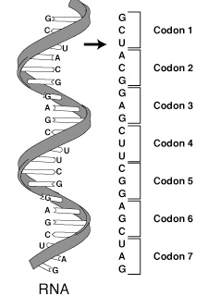
Codons and Reading Frames

Slide 41
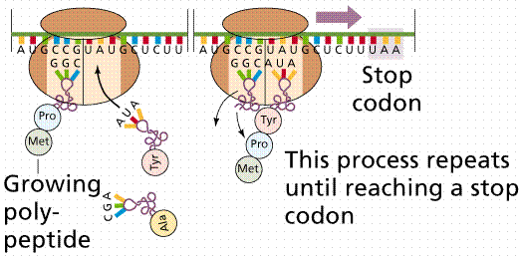
Translation
ribosome
RNA
transfer RNA (tRNA)

Slide 42
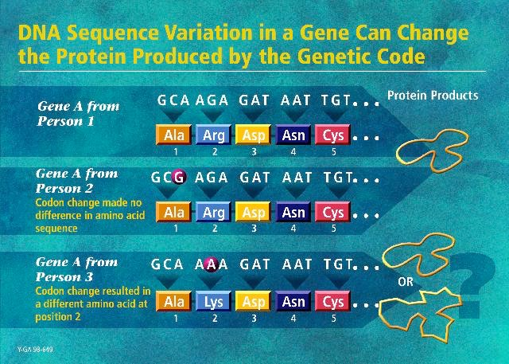
image from the DOE Human Genome Program
http://www.ornl.gov/hgmis

Slide 43
Genes
genes are the basic units of heredity
they are generally the intervals of the genome that are transcribed into RNA
a protein-coding gene is a gene whose RNA carries the information required for constructing a particular protein (polypeptide really)
the human genome comprises ~20,000 protein-coding genes

Slide 44
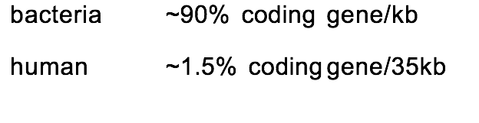
Gene Density
not all of the DNA in a genome encodes protein:

Slide 45
RNA Processing in Eukaryotes
eukaryotes are organisms that have enclosed nuclei in their cells
in many eukaryotes, genes/mRNAs consist of alternating exon/intron segments
exons are the coding parts
introns are spliced out before translation

Slide 46
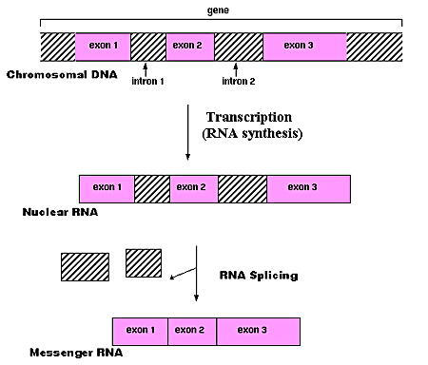
RNA Splicing

Slide 47
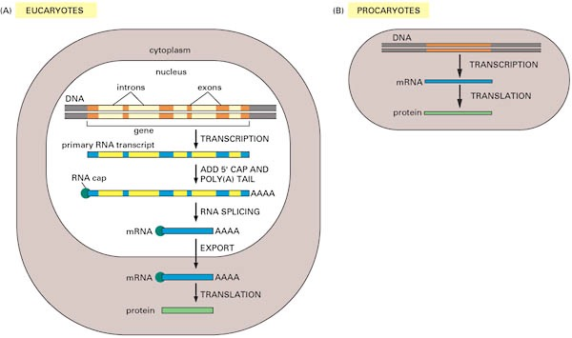
Protein Synthesis in Eukaryotes vs. Prokaryotes

Slide 48
RNA Genes
not all genes encode proteins
for some genes the end product is RNA
ribosomal RNA (rRNA), which includes major constituents of ribosomes
transfer RNAs (tRNAs), which carry amino acids to ribosomes
micro RNAs (miRNAs), which play an important regulatory role in various plants and animals
etc.

Slide 49
The Dynamics of Cells
all cells in an organism have the same genomic data, but the genes expressed in each vary according to cell type, time, and environmental factors
there are networks of interactions among various biochemical entities in a cell (DNA, RNA, protein, small molecules) that carry out processes such as
metabolism
intra-cellular and inter-cellular signaling
regulation of gene expression

Slide 50
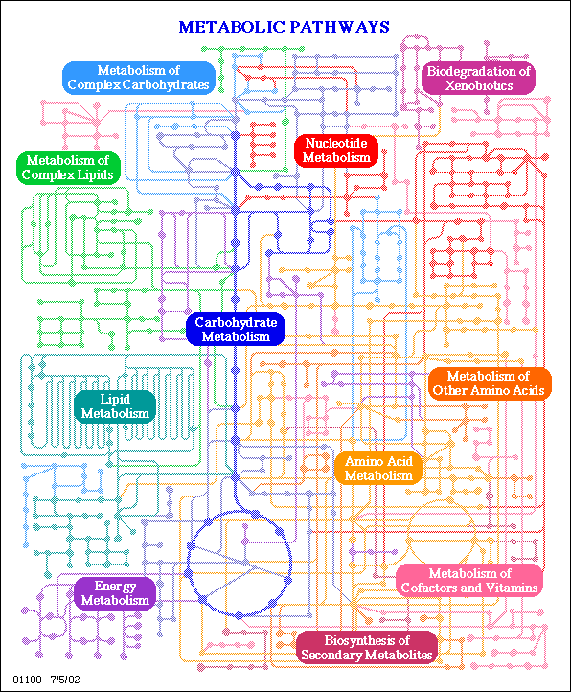
Overview of the E. coli Metabolic Pathway Map
image from the KEGG database

Slide 51
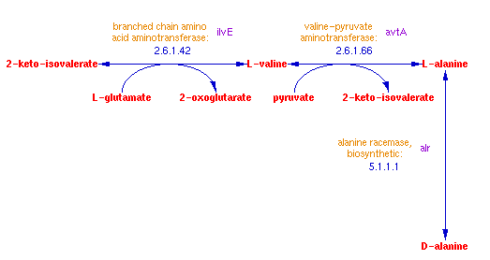
The Metabolic Pathway for Synthesizing the Amino Acid Alanine
reactions
metabolites
enzymes (proteins that catalyze reactions)
genes encoding the enzymes
image from the Ecocyc database
www.biocyc.org

Slide 52
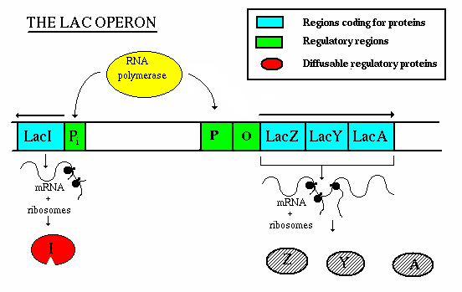
Gene Regulation Example: the lac Operon
this protein regulates the transcription of LacZ, LacY, LacA
these proteins metabolize lactose

Slide 53
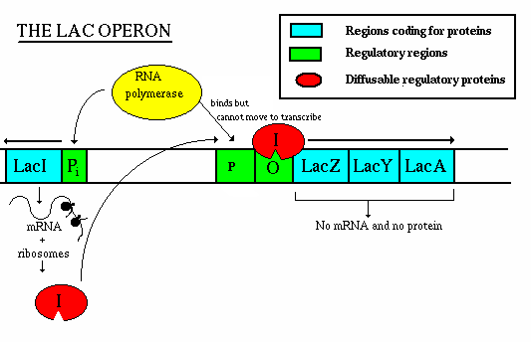
Gene Regulation Example: the lac Operon
lactose is absent ⇒ the protein encoded by
lacI represses transcription of the lac operon

Slide 54
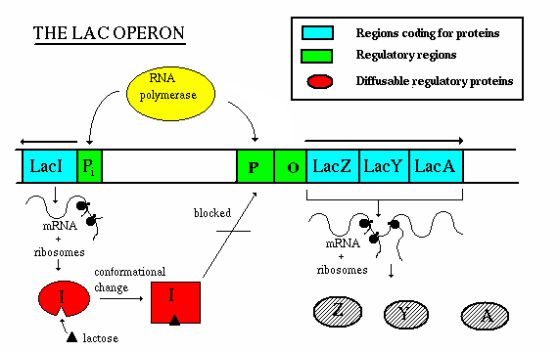
Gene Regulation Example: the lac Operon
lactose is present ⇒ it binds to the protein encoded by lacI changing its shape; in this state, the protein doesn’t bind upstream from the lac operon; therefore the lac operon can be transcribed

Slide 55
Gene Regulation Example: the lac Operon
this example provides a simple illustration of how a cell can regulate (turn on/off) certain genes in response to the state of its environment
an operon is a sequence of genes transcribed as a unit
the lac operon is involved in metabolizing lactose
it is “turned on” when lactose is present in the cell
the lac operon is regulated at the transcription level
the depiction here is incomplete; for example, the level of glucose in the cell also influences transcription of the lac operon

Slide 56
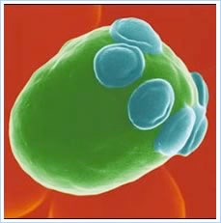

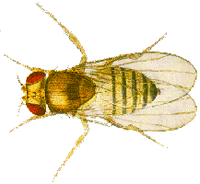
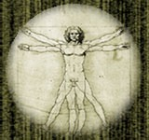
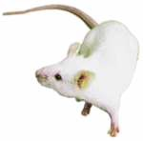
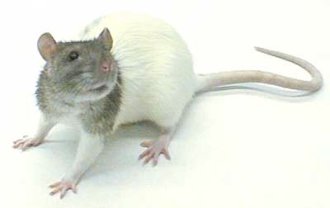
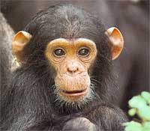
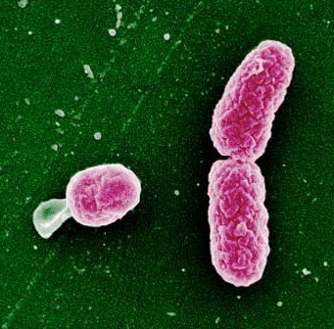
Selected milestones in genome sequencing
 | Year | Common Name | Species | # of Chromosomes | Size (base pairs)
 | 1995 | Bacterium | Haemophilus influenzae | 1 | 1.8 x 10⁶
 | 1996 | Yeast | Saccharomyces cerevisiae | 16 | 1.2 x 10⁷
 | 1998 | Worm | Caenorhabditis elegans | 6 | 1.0 x 10⁸
 | 1999 | Fruit Fly | Drosophila melanogaster | 4 | 1.3 x 10⁸
 | 2000 | Human | Homo sapiens | 23 | 3.1 x 10⁹
 | 2002 | Mouse | Mus musculus | 20 | 2.6 x 10⁹
 | 2004 | Rat | Rattus norvegicus | 21 | 2.8 x 10⁹
 | 2005 | Chimpanzee | Pan troglodytes | 24 | 3.1 x 10⁹
Sequence is freely available
NCBI - http://www.ncbi.nlm.nih.gov
UCSC - http://genome.ucsc.edu

Slide 57
But Wait, There’s More…
> 1000 other publicly available databases pertaining to molecular biology (see pointer to Nucleic Acids Research directory on course home page)
GenBank
> 201 million sequence entries
> 235 billion bases
UniProtKB / Swis-Prot
> 89 million protein sequence entries
> 30 billion amino acids
Protein Data Bank
123,837 protein (and related) structures
all numbers current as of 9/17

Slide 58
More Data: High-Throughput Experiments
RNA abundances
protein abundances
small molecule abundances
protein-protein interactions
protein-DNA interactions
protein-small molecule interactions
genetic variants of an individual (e.g. which DNA base does the individual have at a few million selected positions)
something (e.g. viral replication) measured across thousands of genetic variants
etc.

Slide 59

Example HT Experiment
this figure depicts one yeast gene-expression data set
each row represents a gene
each column represents a measurement of gene expression (mRNA abundance) at some time point
red indicates that a gene is being expressed more than some baseline; green means less
Figure from Spellman et al., Molecular Biology of the Cell, 9:3273-3297, 1998

Slide 60

More Data: Interactions
each node represents a gene product (protein)
blue edges show direct protein-protein interactions
yellow edges show interactions in which one protein binds to DNA and affects the expression of another
Figure from Ideker et al., Science 292(5518):929-934, 2001

Slide 61
Significance of the Genomics Revolution
Data driven biology
functional genomics
comparative genomics
systems biology
Molecular medicine
identification of genetic components of various maladies
diagnosis/prognosis from sequence or expression
gene therapy
Pharmacogenomics
developing highly targeted drugs
Toxicogenomics
elucidating which genes are affected by various chemicals

Slide 62
Bioinformatics Revisited
Representation/storage/retrieval/ analysis of biological data concerning
sequences (DNA, protein, RNA)
structures (protein, RNA)
functions (protein, sequence signals)
activity levels (mRNA, protein, metabolites)
networks of interactions (metabolic pathways, regulatory pathways, signaling pathways)
of/among biomolecules

